Slide 1
Pesky AC123!
Get accession numbers out of scopecontent and into unitid using XPath and regex in the oXygen editor

Slide 2
Current Desired
<c level="file" id="AC123_c05939"> <did> <container type="volume">
Accession Book 6
</container> <unittitle>
undated
</unittitle> <unitdate>
undated
</unitdate> <physdesc> <extent type="computed">
1 volume
</extent> </physdesc> </did> <scopecontent> <p>
Includes accession numbers 25001-30000.
</p> </scopecontent> </c>
<c level="file" id="AC123_c05939"> <did>
<unitid type="accessionnumber">
25001-30000
</unitid> <container type="volume">
Accession Book 6
</container> <unittitle>
undated
</unittitle> <unitdate>
undated
</unitdate> <physdesc> <extent type="computed">
1 volume
</extent> </physdesc> </did> </c>
Notes:
Uhm, a little aside here… There is obviously more wrong with AC123—we'll just ignore the fact that single items seem to be associated with ranges of accession numbers, or that the title and the date are the same, etc.
The task at hand, then, is to grab the accession number--range or not--from the unstructured note field and put it in the appropriate data field (unitid), and to delete the now-superfluous note field.

Slide 3
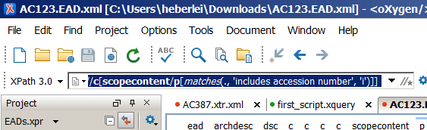
//c [ scopecontent/p [matches(., 'includes accession number', 'i')] ]
Notes:
Ok, so this part we did yesterday—let's look at the problem first, using the XPath explorer. I've given you the XPath above for easy copy/pasting, and I've broken it down a bit for ease of reading. To wit:
Return any c that has a grandchild p (child of scopecontent) that contains the string 'includes accession number'.
Results in 133 matching components.

Slide 4
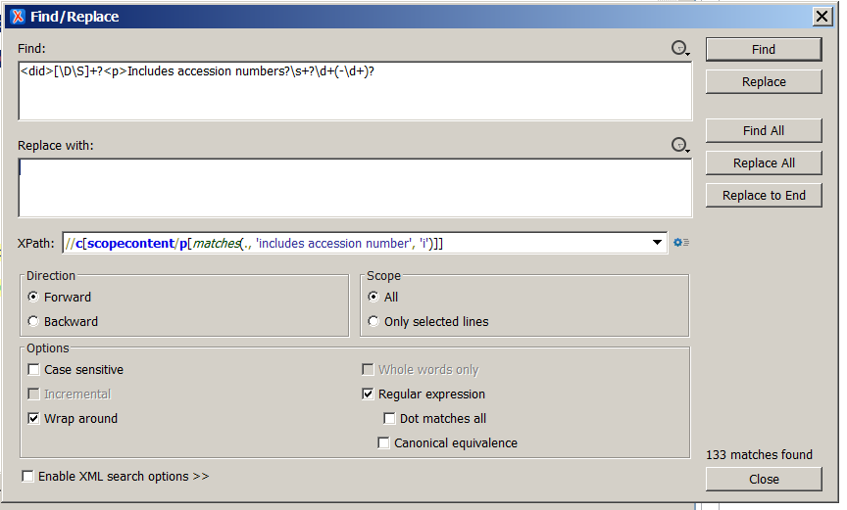
<did>[\D\S]+?<p>Includes accession numbers?\s+?\d+(-\d+)?
Notes:
Now, what do we do with those components?
First, copy/paste that XPath in the XPath filter in your find/replace (remember to take off the leading '//'). Then, let's build a search string, thinking ahead to what we need to do next: we need to retrieve 1) our accession number and 2) a place to put it.
So, what I'm doing with the regex above is this: find the string 'did' followed by as many characters of any kind as you can find until you come up against the string '<p>Includes accession number' followed by an optional 's' followed by as many digits as you can find until you come up against an optional group of characters consisting of one hyphen followed by as many digits as you can find (i.e., before you come up against a non-digit).
Make sense?
Why, you ask, do I start this high up in the component, with the <did>? Because I'll use the opening <did> tag as my milestone: I'll deposit my new unitid right inside it. Stay tuned.
Now run a "find all" to make sure we're still finding 133 things. Click on a few results and make sure the regex is selecting the entire number. Make sure the regex box is checked and XML search options are disabled.
NB—I did have a bug in my regex. I had made the \d+ lazy by adding the ?. That, however, only retrieves the first digit of each number! So here is the de-bugged version. (Though the behavior I was getting from my editor was "string not found", which seems to be yet something else going on that I can't explain. Go figure.)

Slide 5
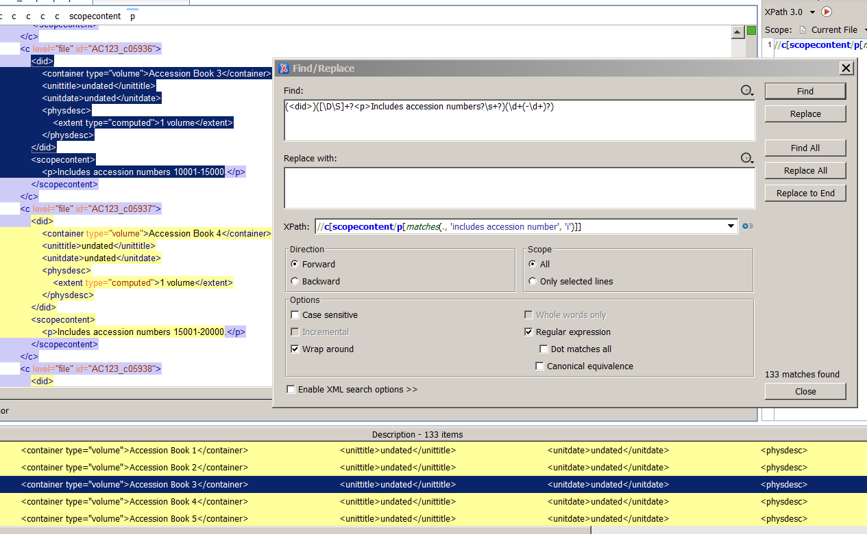
(<did>) ([\D\S]+?<p>Includes accession numbers?\s+?) (\d+(-\d+)?)
Notes:
Ok, now what? Now we group so that we can start moving around some strings. Like so.
Run a "find all" again to make sure you're still getting 133 matches.
(If you copy-pasted the search string, make sure to take out the whitespace in between the closing and opening parentheses, else it will consider them literals (and not find anything).)

Slide 6
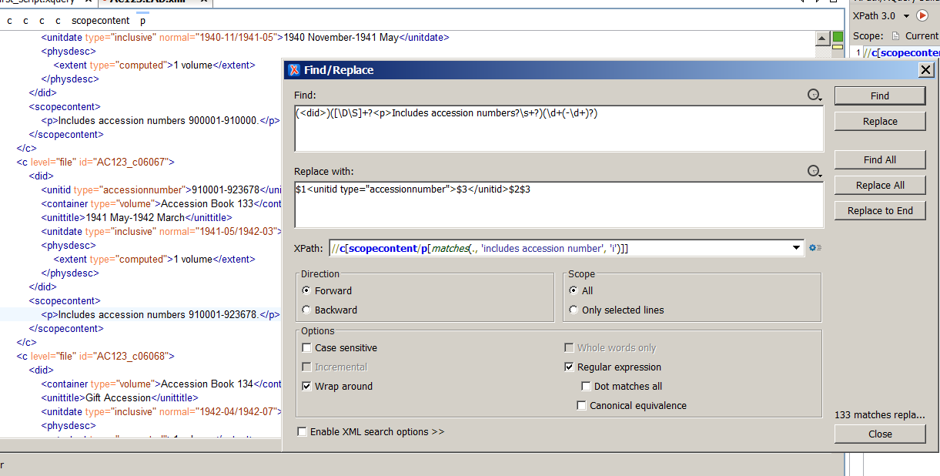
$1<unitid type="accessionnumber">$3</unitid>$2$3
Notes:
Aha! So far, so good. Now, let's move stuff around. This is the replacement string we'll use. What does it do? It
replaces group 1 (the did tag) with itself
inserts an opening unitid tag
inserts group 3 (the accessionnumber, which will become the value of the unitid element)
inserts the closing unitid tag
replaces group 2 (everything up to the accession number) and group 3 (the accession number) with themselves, i.e., puts everything back where it was
Are you ready? Go ahead, hit "replace all"!

Slide 7
Eh? ☺
<c level="file" id="AC123_c06066"> <did> <unitid type="accessionnumber">900001-910000</unitid> <container type="volume">Accession Book 132</container> <unittitle>1940 November-1941 May</unittitle> <unitdate type="inclusive" normal="1940-11/1941-05">
1940 November-1941 May
</unitdate> <physdesc> <extent type="computed">1 volume</extent> </physdesc> </did> <scopecontent> <p>Includes accession numbers 900001-910000.</p> </scopecontent> </c>
Notes:
Check your data. Looking good?
It's a good idea at this point to spot-check to make sure you didn't leave any characters behind, or carry extra ones with you, etc.

Slide 8
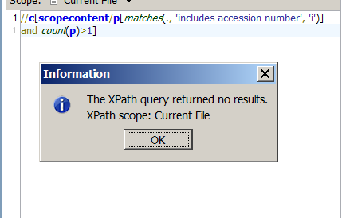
//c [ scopecontent/p [matches(., 'includes accession number', 'i')] and count(p)>1 ]
Notes:
Ok, half-way there, with the heavy lifting done! Now let's clean up the scopecontent.
We know something helpful from examining the data: We can delete the entire scopecontent/p with the accession number in it, because there is no other information in that same p that we need to save. That means we can do this next step as mostly an XPath operation.
We do, however, have to do some due diligence:
We can't just delete scopecontent wholesale—it might have other p's in it.
Nor can we simply delete the scopecontent/p with the accession number in it—that might leave behind an empty scopecontent.
So, let's check for the same scopecontent/p's with the accession number in it, with an added filter that checks whether there are any other p's. Just run this from the XPath explorer for a quick data check.
…Nope, there aren't any! Good to go to delete the entire scopecontents with matching p's then.

Slide 9
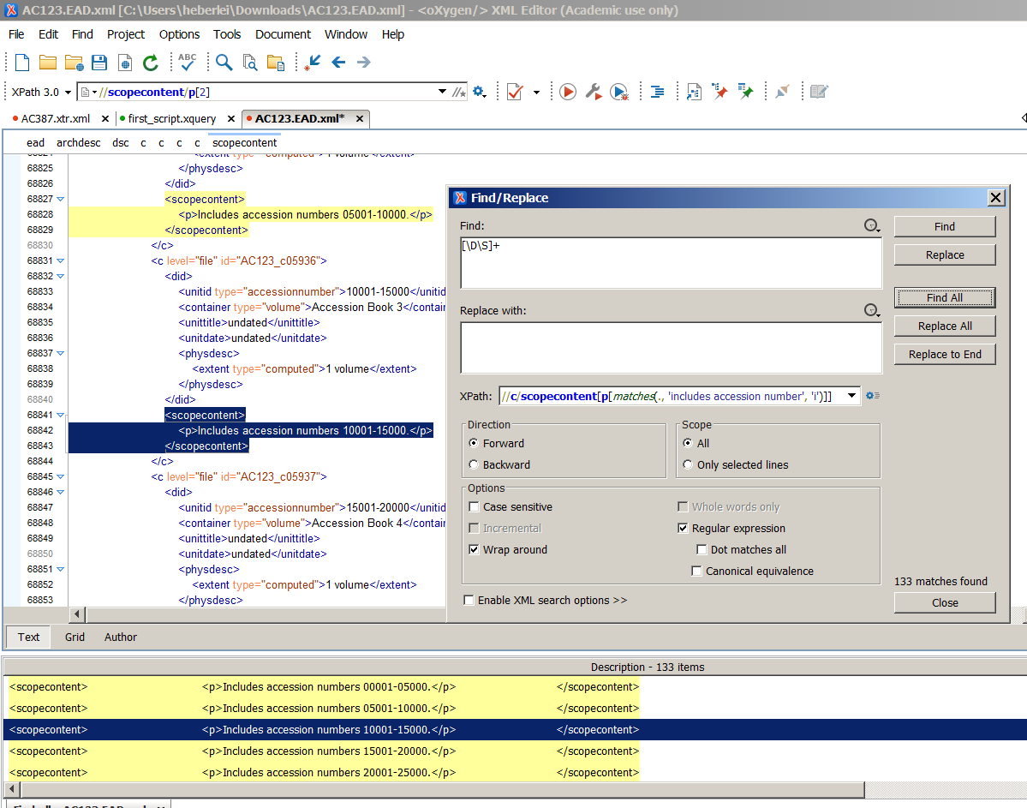
c/scopecontent [p[matches(., 'includes accession number', 'i')]]
Notes:
Just a small tweak to our earlier XPath needed so we return the scopecontent instead of the entire c. Note that I am still using the step from c to scopecontent: just in case there is a matching scopecontent at the collection level, which I wouldn't want to be included in the delete operation.
Now we use the famous [\D\S]+ in the search string to match on the entire element (make sure your XML search options are disabled) and replace with nothing. Hit replace all, and…

Slide 10
<c level="file" id="AC123_c06067"> <did> <unitid type="accessionnumber">
910001-923678
</unitid> <container type="volume">
Accession Book 133
</container> <unittitle>1941 May-1942 March</unittitle> <unitdate type="inclusive"
normal="1941-05/1942-03">
1941 May-1942 March
</unitdate> <physdesc> <extent type="computed">1 volume</extent> </physdesc> </did> </c>
Notes:
Tadaa!
(Now, what do you want to do next? ;-) )

